Slide 1
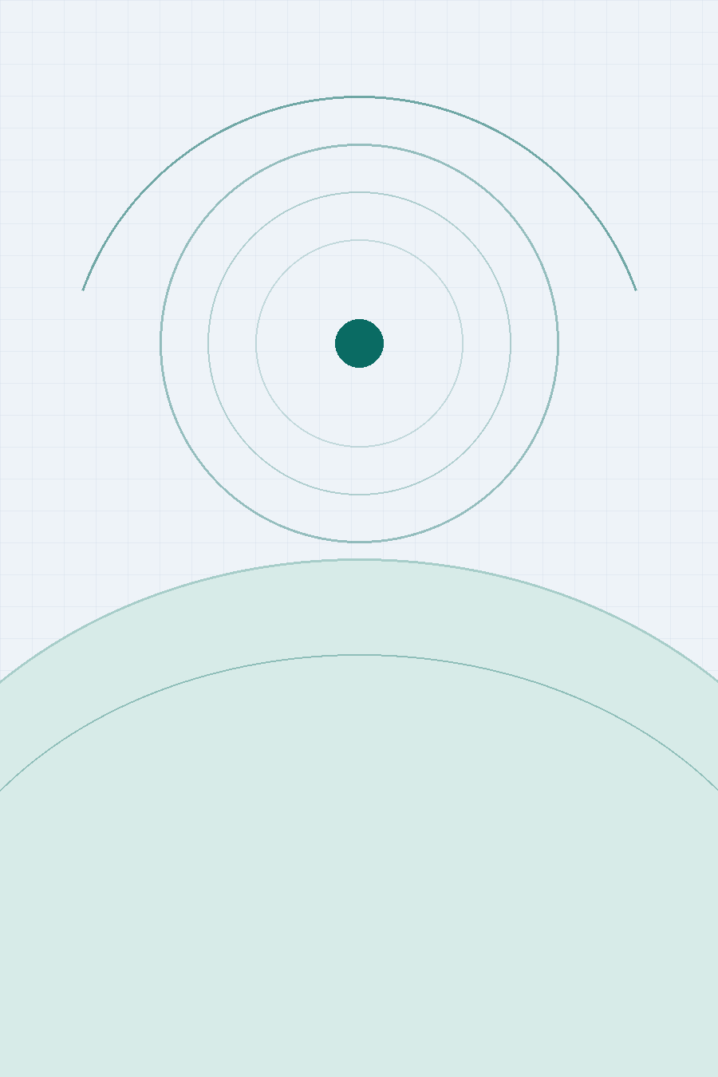
CONFIDENTIAL INVESTOR PRESENTATION
Samuel Space
Organ and Tissue
Engineering
Manufacturing the next generation of human tissue — in orbit.
Series A Financing
June 2026
1

Slide 2
NOTICE
Confidential — Forward-Looking Statement
This presentation has been prepared by Samuel Space Organ and Tissue Engineering ("the Company") solely to assist prospective investors in evaluating a potential investment. It is confidential and may not be reproduced or distributed, in whole or in part, without the Company's prior written consent.
This presentation contains forward-looking statements, including projections of financial and operating performance, market size, regulatory timelines, and technology milestones. These statements reflect current expectations and assumptions and are subject to significant risks and uncertainties; actual results may differ materially. Nothing herein constitutes an offer to sell, or a solicitation of an offer to buy, any securities, and any such offer will be made only pursuant to definitive offering documents.
Certain industry, market, and scientific data in this presentation has been compiled from third-party sources — including government agencies, peer-reviewed publications, and public company disclosures — as cited in the Appendix. The Company has not independently verified all such data and makes no representation as to its completeness or accuracy.
Samuel Space | Confidential
2

Slide 3
EXECUTIVE SUMMARY
Translating Proven Orbital Science Into a Commercial Tissue Platform
103,223
13 / day
$1.7B–$3.5B+
8 years
People on the U.S. transplant
waitlist today (OPTN, 2025)
Americans die waiting for
a donor organ
Global bioprinting market
2025 to 2030 (~16% CAGR)
Continuous in-orbit
bioprinting validation
1
2
3
4
The Problem
The Unlock
The Market
The Ask
Organ and tissue shortages persist globally. Earth-based bioprinting hits a physical ceiling: gravity causes tissues to collapse without a temporary scaffold, limiting achievable geometry.
Microgravity eliminates scaffold dependency. NASA, Redwire, ESA, LambdaVision and ROSCOSMOS have validated the science aboard the ISS continuously since 2018.
A $1.7B market growing at ~16% CAGR, the first FDA-cleared tissue-engineered vascular graft (Symvess, Dec 2024), and four commercial stations entering service from 2026.
An $18M Series A to build Samuel's first flight-qualified payload platform, commercialise wound-care and orthopedic verticals, and file NASA InSPA Phase 1 grants.
Samuel Space | Confidential
3

Slide 4
THE PROBLEM
A Global Organ & Tissue Crisis
U.S. Transplant Waiting List by Organ (2025)
941,652
CVD deaths in the U.S. in 2022 — still the #1 cause of death, killing more people than all cancers combined
~1 per 34 sec
A cardiovascular death occurs in the U.S. on average every 34 seconds — roughly 2,500 per day
10% met
Of the estimated global transplant need. WHO reports ~130,000 transplants/yr vs. demand exceeding 1.3M
Source: OPTN / organdonor.gov, 2025
Source: AHA 2025 Heart Disease & Stroke Statistics; WHO Global Observatory on Donation and Transplantation.
Transplant recipients also face a lifetime of immunosuppressive therapy and rejection risk. Tissue printed from a patient's own cells eliminates cross-reactive rejection entirely — removing both the clinical burden and the ongoing drug cost.
Samuel Space | Confidential
4

Slide 5
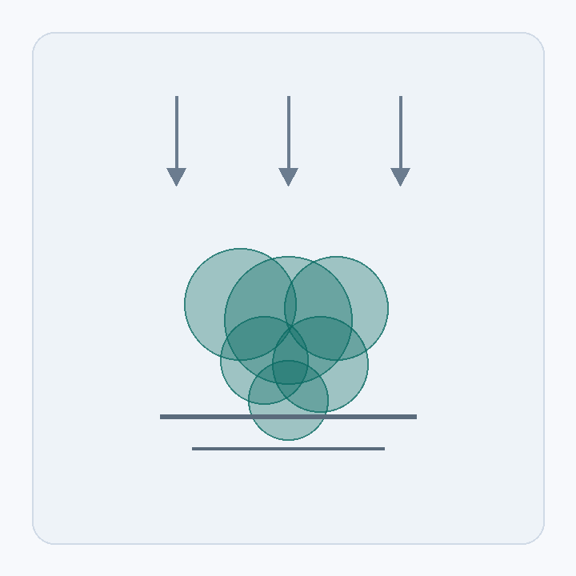
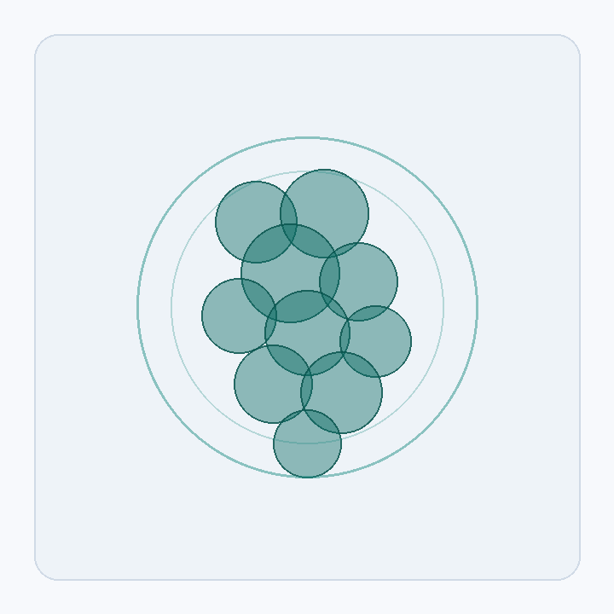
THE CORE CONSTRAINT
Why Earth-Based Bioprinting Has a Hard Ceiling
On Earth, gravity forces tissues to collapse under their own weight during printing. A scaffold must be built into every construct, adding complexity, introducing foreign material, and limiting achievable geometry. Microgravity removes this constraint entirely.
EARTH GRAVITY
MICROGRAVITY — ISS ORBIT
– Cells slump and fuse unevenly under gravitational load
– Scaffold material printed first, then must be dissolved
– Complex hollow structures (e.g. heart chambers) extremely difficult
– Tissue self-supports in true 3D — no scaffold required
– More uniform cell distribution and structural integrity
– Complex vascular and hollow geometries become achievable
Samuel Space | Confidential
5

Slide 6
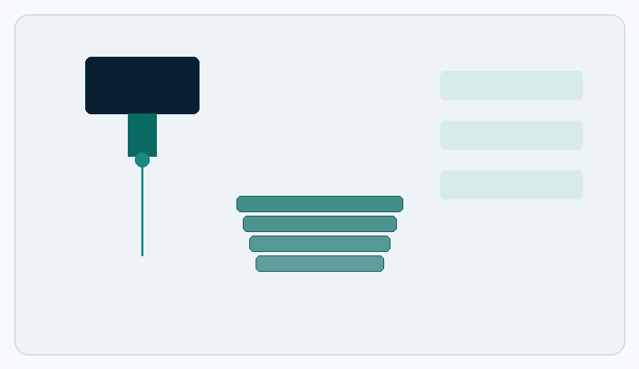
THE TECHNOLOGY
How Space-Based Bioprinting Works: Five-Step Process
1
2
3
4
5
Cell Harvest
Stem Cell Reprogramming
Bioink Formulation
In-Orbit Printing
Tissue Maturation
Biopsy yields patient-specific cells, eliminating immunological rejection risk
Nobel-winning iPSC method converts adult cells to pluripotent stem cells
Cells suspended in hydrogel optimised for printing viscosity and cell viability
Layer-by-layer deposition in microgravity — no scaffold required
Bioreactor conditioning allows cells to differentiate into target tissue type
Why orbit?
In the near-weightlessness of ISS orbit (~400 km altitude), tissues grow in true three dimensions with no gravitational compression. This principle has been validated continuously since 2018 across NASA, Redwire Corporation, ROSCOSMOS, LambdaVision Inc., and ESA/DLR — eight years of confirmation by organisations operating entirely independently of one another.
Schematic: layer-by-layer orbital bioprinting hardware
Note: Adult cardiac muscle cannot self-regenerate — damaged tissue is replaced by scar tissue that blocks electrical signals, a key driver of CVD mortality and why cardiac is Samuel's highest-value target vertical.
Samuel Space | Confidential
6

Slide 7
PRODUCT STRATEGY
Four High-Value Clinical Verticals
01
Cardiac Tissue
02
Orthopedic Grafts
CVD kills ~2,500 Americans daily. Adult heart tissue cannot regenerate. Redwire returned the first live human cardiac tissue from orbit in May 2024 under BFF-Cardiac.
Meniscal tears are among the most common U.S. military injuries. Redwire printed the first human knee meniscus in orbit in September 2023, establishing the foundational protocol.
Proven by: Redwire BFF-Cardiac, ISS, May 2024
Proven by: Redwire BFF-Meniscus-2, ISS, Sept 2023
03
Artificial Retinas
04
Wound Care Patches
30 million people worldwide suffer from degenerative retinal disease. LambdaVision has produced consistent 200-layer protein retina films in microgravity across 9 ISS missions.
ESA and DLR demonstrated a handheld bioprinter creating customised skin patches aboard the ISS during the Cosmic Kiss mission. Lowest regulatory burden — Samuel's Phase 1 entry point.
Proven by: LambdaVision / Space Tango, 9 ISS missions
Proven by: ESA/DLR Bioprint FirstAid, ISS, Dec 2021
Samuel Space | Confidential
7

Slide 8
THIRD-PARTY VALIDATION
Eight Years of Proven In-Orbit Bioprinting
Every milestone below was publicly announced by an independent organisation — not by Samuel Space.
2018
Dec '21
May '24
2026
ROSCOSMOS Organ.Aut
ESA Bioprint FirstAid
First Cardiac Tissue
Commercial Pivot
First magnetic 3D bioprinter on ISS; tissue constructs created 2018–2020 prove in-orbit approach
Portable handheld bioprinter demonstrated by astronaut Matthias Maurer on Cosmic Kiss mission
Redwire returns first live 3D-bioprinted human cardiac tissue from ISS under BFF-Cardiac
LambdaVision closes $7M seed; commercial station payload slots reserved ahead of ISS 2030 retirement
2019
Sep '23
Sep '25
Redwire BFF Launched
First Knee Meniscus
Grants & Contracts
BioFabrication Facility (Techshot/nScrypt) arrives on ISS; later wins Popular Science Best of What's New 2023
Redwire BFF prints first human knee meniscus in orbit — musculoskeletal milestone
LambdaVision wins NASA InSPA Phase 2; Redwire awarded $25M NASA IDIQ for continued ISS work
Samuel Space | Confidential
8

Slide 9
MARKET OPPORTUNITY
A Rapidly Expanding Global Addressable Market
Global 3D Bioprinting Market 2023–2030 (USD $B)
$3.5B+
Projected global 3D bioprinting market by 2030 at ~15.9% CAGR (Mordor Intelligence, Jan 2026)
Dec 2024
FDA cleared Symvess — first tissue-engineered vascular graft — setting a direct regulatory precedent
$420M+
Committed by pharma companies to commercial-station research programs through 2030 (industry research)
$200–400M
Samuel's estimated initial SAM by 2030 (cardiac patches, ortho grafts, retinal constructs)
Source: Mordor Intelligence, 3D Bioprinting Market Report, Jan 2026 · ~15.9% CAGR
Samuel Space | Confidential
9

Slide 10
MARKET TIMING
Four Converging Tailwinds Create a Unique Entry Window
~89%
4
reduction in launch cost/kg since 2010
NASA-funded commercial station programs
Launch Costs Have Collapsed
Commercial Stations Are Coming
Cost-to-orbit has dropped from ~$54,000/kg (Space Shuttle era) to ~$6,000/kg (Falcon 9). Starship is expected to reduce this further. Research payloads that were cost-prohibitive a decade ago are now commercially viable.
ISS retires ~2030. NASA's CLD program has funded four successors: Starlab (Voyager/Airbus, targeting 2029), Axiom Station, Orbital Reef (Blue Origin/Sierra Space), and Vast Haven-1. Samuel is designed station-agnostic from day one.
Dec 2024
$329M
First FDA-cleared tissue-engineered vascular graft
Raised by Varda Space (in-space manufacturing)
Regulatory Precedent Is Set
Capital Is Already Flowing
The FDA cleared Symvess — the first tissue-engineered synthetic vascular graft — in December 2024. This is the single most important regulatory precedent for clinical bioprinted tissue and validates the FDA's review pathway.
Varda Space Industries has raised $329M total, including a $187M Series C (July 2025) led by Natural Capital and Shrug Capital with Founders Fund and Khosla Ventures. LambdaVision closed a $7M seed atop $15M+ in non-dilutive grants.
Samuel Space | Confidential
10

Slide 11
OUR PLATFORM
Station-Agnostic Payload Platform
Samuel Space is built as a payload integrator and tissue manufacturing platform — hardware-compatible across all emerging commercial LEO stations. The same flight-qualified platform, bioink libraries, and protocols deploy whether the payload flies on the ISS, Starlab, Axiom, Orbital Reef, or Vast.
STATION ECOSYSTEM COMPATIBILITY
Samuel Space Platform
01
Modular Payload Design
ISS
Hardware footprint matches standard double-locker form factor compatible with ISS, Starlab, and Axiom interfaces — one build, many stations.
Redwire BFF — active now through ~2030
Starlab
02
Proprietary Cell-Line IP
Voyager/Airbus JV — targeting 2029 launch
Bioink formulations and printing protocols optimised for microgravity are the core defensible IP asset, accumulated across every mission flown.
Axiom Station
First commercial modules ~2026–2028
03
Service-First Revenue
Fee-for-service bioprinting generates near-term revenue from pharma and academic customers while building the IP base that creates long-term enterprise value.
Orbital Reef
Blue Origin/Sierra Space — CLD-funded
Vast Haven-1
First dedicated commercial station, 2026
Station names shown as market context only — not as confirmed Samuel partnerships.
Samuel Space | Confidential
11

Slide 12
EXECUTION PLAN
Four-Phase Technology & Commercialisation Roadmap
PHASE 1
PHASE 2
PHASE 3
PHASE 4
Years 1–2
Years 3–5
Years 6–9
Year 10+
Platform & Wound Care
Orthopedic & Cardiac
Retinal & Vascular
Whole-Organ Platform
– ISS payload hardware certification
– Commercial wound-care patch trials
– NASA InSPA Phase 1 grant applications
– Research tissue models for pharma CROs
– 510(k) filing for wound-care products
– Orthopedic graft BFF-compatible program
– Cardiac patch preclinical studies
– Series B fundraise
– Clinical trials for retinal constructs
– FDA PMA pathway engagement
– Expand to Orbital Reef / Axiom
– Series C / pre-IPO raise
– Vascularised full-organ constructs
– Commercial station scale-up
– Platform licensing to pharma majors
– IPO or strategic exit
TRL 4 → 6
TRL 6 → 8
TRL 7 → 9
TRL 9+
Samuel Space | Confidential
12

Slide 13
COMPETITIVE LANDSCAPE
Samuel Space Targets the Space-Based Clinical Quadrant
EARTH-BASED
SPACE-BASED
CLINICAL / COMMERCIAL
Samuel Space (target)
3D Systems (Med)
LambdaVision
Cellink / BICO
Redwire BFF
Organovo
Entry
ROSCOSMOS / 3D BPS
EARLY RESEARCH
Positions are illustrative, based on public technology and commercialisation-stage disclosures.
Samuel Space | Confidential
13

Slide 14
REVENUE MODEL
Three Complementary Revenue Streams
01
REVENUE STREAM 1
Contract Bioprinting Services
Near-Term Revenue
Fee-for-service orbital bioprinting missions for pharmaceutical companies, academic medical centres, and government research agencies, modelled on how Redwire's BFF and Space Tango currently operate commercially. Revenue begins in Year 1.
02
REVENUE STREAM 2
Non-Dilutive Grant Funding
Reduces Equity Burn
NASA InSPA, ESA BIC, DoD SBIR/STTR, and National Eye Institute mechanisms provide substantial non-dilutive capital. LambdaVision has secured $15M+ cumulatively; Redwire holds a $25M NASA IDIQ. Samuel targets $4–8M in grants across Years 1–4.
03
REVENUE STREAM 3
Tissue IP Licensing & Royalties
Long-Term Value Driver
As proprietary bioink formulations and protocols demonstrate clinical-grade output, Samuel licenses IP to pharmaceutical and device manufacturers. This becomes the primary long-term value driver, targeted from Year 3 onward.
Samuel Space | Confidential
14

Slide 15
GO-TO-MARKET
Sequenced Market Entry Across Four Partner Categories
1
2
3
4
Commercial Station Operators
Payload Integrators & CROs
Pharma & Academic Medical Centres
Government & Grant Agencies
Redwire (active BFF operator), Starlab (Voyager/Airbus JV), Axiom Space, Blue Origin Orbital Reef, and Vast Haven-1. Samuel negotiates research-service agreements and payload manifesting rights with each.
Partners such as Space Tango, LambdaVision's enabling integrator, provide environmental control, crew interface, and downlink services. Samuel outsources non-core integration to move faster and preserve capital.
Initial contract-service revenue comes from pharmaceutical R&D divisions seeking orbital tissue models for drug screening, and from NIH-funded academic biotech groups with institutional mandates.
NASA (InSPA, SBIR/STTR), ESA, NIH National Eye Institute, and DoD MTEC provide non-dilutive grant capital that de-risks early development and validates the technology for commercial buyers.
Redwire, Starlab, Axiom, Vast
Space Tango, Nanoracks/Voyager
Pharma R&D, NIH-funded labs
NASA, ESA, NIH NEI, DoD MTEC
Samuel Space | Confidential
15

Slide 16
FINANCIALS — ILLUSTRATIVE
Five-Year Revenue Model (Illustrative Projections)
Figures are illustrative projections for investor discussion purposes only. Actual results will vary materially.
Year | Total Rev. | Key Driver
Year 1 | $0.8M | First service contracts + NASA grant
Year 2 | $2.4M | Expanded services + IP licensing launch
Year 3 | $6.1M | Cardiac/ortho milestones + Starlab start
Year 4 | $13.5M | IP licensing deals + multi-station ops
Year 5 | $24.2M | Full vertical scale-up across four verticals
Samuel Space | Confidential
16

Slide 17
THE ASK
An $18M Series A to Reach First Commercial Flight
ROUND SIZE
$18M
~30 months
2
3–5
Series A Preferred Equity
Runway to next value-inflection milestone
Product verticals reaching clinical pilot stage
Targeted commercial flight missions secured
Allocation figures are illustrative and subject to diligence.
Use of Funds
Key Use-of-Funds Milestones
40%
R&D / Payload Development
– Flight-qualify modular payload hardware
– Complete 3–5 commissioned ISS missions
– File first NASA InSPA Phase 1 grant
– Secure Starlab payload reservation
– Build core scientific & engineering team
25%
Flight & Integration Costs
15%
Regulatory & Clinical Prep
15%
Team Build-Out
5%
G&A
Samuel Space | Confidential
17

Slide 18
RISK FACTORS
Key Risks and Mitigating Strategies
Risk Category | Risk | Mitigant
Technical | Scaling from validated tissue patches to full vascularised organs remains scientifically unsolved industry-wide. | Phased roadmap monetises near-term, lower-complexity verticals (wound care, orthopedic) before attempting whole-organ printing.
Regulatory | FDA approval pathways for novel tissue-engineered products are long, costly, and precedent-limited. | Symvess clearance (Dec 2024) establishes the first direct precedent. Samuel engages regulatory counsel from Year 1 and targets lower-risk 510(k) products first.
Platform / Access | ISS retirement (~2030) creates dependency risk if commercial successor stations are delayed. | Station-agnostic hardware design supports ISS, Starlab, Axiom, Orbital Reef, and Vast simultaneously, diversifying single-platform exposure.
Capital Intensity | Flight missions, payload hardware, and clinical trials require sustained, significant capital investment. | Blended funding strategy combines equity with non-dilutive NASA/ESA/DoD grants, following the precedent set by LambdaVision and Redwire.
Competitive | Incumbent operators (Redwire, LambdaVision) hold first-mover relationships with NASA and station operators. | Samuel differentiates on multi-vertical platform breadth and station-agnostic flexibility rather than competing head-on for any single contract.
Samuel Space | Confidential
18

Slide 19
ORGANISATION
Team & Scientific Advisory Approach
Samuel Space is building a founding team and Scientific Advisory Board around the specific expertise this platform requires. Roles below reflect the Company's hiring plan and target advisory profile for the Series A period.
01
Founder / Chief Executive Officer
02
Chief Scientific Officer
Commercial space or biotech venture leadership; track record building regulated hardware or therapeutics businesses from seed to scale.
PhD-level expertise in tissue engineering, stem cell biology, or regenerative medicine; prior peer-reviewed bioprinting research.
03
VP, Payload Engineering
04
Head of Regulatory Affairs
Aerospace hardware engineering background; experience flight-qualifying instrumentation for ISS or commercial LEO payloads.
FDA medical device / biologics regulatory pathway expertise; experience navigating 510(k) and PMA submissions.
Scientific Advisory Board — In Formation
Samuel is actively recruiting an SAB spanning the disciplines proven essential by the field's existing leaders: stem-cell and cardiac tissue biology (in the tradition of Harvard's bioengineering research community), microgravity payload design (as demonstrated by Redwire's BFF engineering team), and protein-based biomanufacturing (as practiced by LambdaVision and Space Tango). Target SAB appointments will be announced as the round closes.
Samuel Space | Confidential
19

Slide 20
THE OPPORTUNITY
Every organ printed in orbit
is a life that didn't have to wait.
Samuel Space stands at the intersection of two converging trends: a mature, validated microgravity bioprinting science base, and the arrival of commercial space stations built for exactly this kind of work. The science already works. What's needed now is a company built to commercialise it.
Samuel Space Organ and Tissue Engineering
investors@samuelspace.com (placeholder)
20

Slide 21
APPENDIX
Sources & References
Bioprinting Science & Technology
Market, Regulatory & Industry Data
– NASA — "3D Bioprinting" research overview, iss-research program page
– NASA — BioFabrication Facility mission page, Redwire Corporation
– Redwire Corporation — Newsroom: BFF-Meniscus first human knee meniscus printed in orbit, Sept 2023
– Redwire Corporation — BFF-Cardiac investigation announcements and ISS return coverage, 2024
– Redwire Corporation — NASA IDIQ contract award coverage, Sept 2025
– ESA / DLR — Bioprint FirstAid investigation overview, Cosmic Kiss mission materials
– LambdaVision Inc. — Press releases: Space Tango partnership, NASA InSPA Phase 2 award, seed financing, 2025–2026
– ROSCOSMOS — 3D MBP / Organ.Aut magnetic bioprinter mission summaries, 2018–2020
– American Heart Association — 2025 Heart Disease & Stroke Statistics Update
– OPTN / organdonor.gov (HRSA) — U.S. transplant waiting list data, 2025
– World Health Organization — Global Observatory on Donation and Transplantation
– Mordor Intelligence — 3D Bioprinting Market Report, updated January 2026
– U.S. FDA — Symvess (acellular tissue-engineered vessel) clearance announcement, Dec 2024
– NASA Commercial LEO Destinations (CLD) program — Starlab, Axiom, Orbital Reef, Vast program pages
A Note on Methodology
All third-party scientific milestones, dates, and figures in this presentation are drawn from the public sources listed above and were current as of the citation date shown. Samuel Space Organ and Tissue Engineering is an independent platform company; references to NASA, Redwire, LambdaVision, ROSCOSMOS, and ESA/DLR describe industry validation of the underlying science, not partnerships, endorsements, or affiliations with Samuel Space.
Samuel Space | Confidential
21

